Slide 1




Ingenious Solutions
N-11, Site – V, Kasna Industrial Area, Greater Noida – 201308 (UP)
POC – Mr. Navneet Kaushik (Mob-9990623421, 9711616470), Mr. Samarth Vaid (Mob-9811863149)
Email – sknsales2@gmail.com, ingenioussolutionsbd1@gmail.com, Website – www.sknindustries.com

Slide 2



Ingenious Glimpse
About Us
Inherent with business ethics and skill sets for design and deployment of solution.
No Box to Box replacement – innovation is the zest of Ingenious with out of the box ideology.
Team of educated and highly experienced people in the real field of operations.
Ingenious Solutions

Slide 3
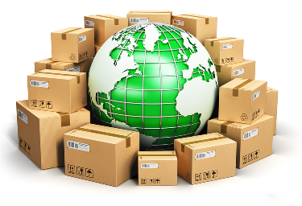
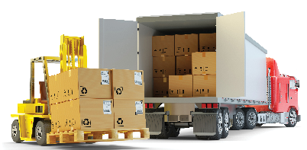
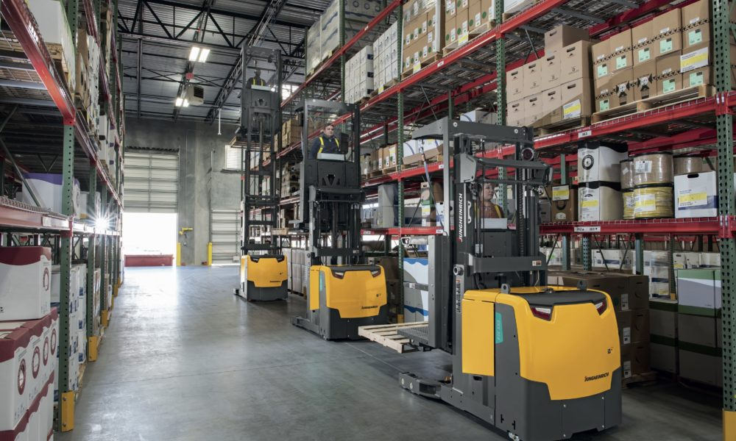
Ingenious Glimpse
Solutions by Us
Sustainable – Primary/Secondary/Territory Packaging Solutions with or without Automation
Tailored & Optimized –
Warehouse Solution Setup/ Automation/Process Enhancement Logistics Solution for FTL & LTL/Part Loads – Domestic & Exports.
+
Ingenious Solutions

Slide 4
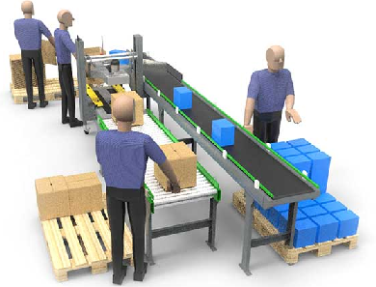
Packaging Solutions
Packaging
Packaging Design and Solution (Domestic/Export Standardization)
Packaging Process Improvement (Packaging / Pre-packaging)
Sustainability Performance (Waste reduction –Carbon Footprint)
Cost Reduction (Vendor Consolidation, Automation)
Ingenious Solutions

Slide 5
Packaging Solutions
What Ingenious ‘Can Do’
By serving as the single point of contact, we help your company to manage the complexities of packaging. To develop a customised solution, it is crucial to understand how your packaging is performing. We begin with a conversation that includes the following questions:
What is your product damage rate due to packaging?
What are your handling and repackaging costs?
How are packaging inefficiencies negatively affecting your profitability?
What are your sustainability goals?
Areas of improvements in pre-packaging process?
Though each program is unique and customised, we use the process of Discover, Design and Deliver to ensure your packaging solution is aligned with your business goals.
Ingenious Solutions

Slide 6
Packaging Solutions
How Ingenious ‘Can Do’
Discover
We take a close look at your supply chain to identify savings opportunities, uncover inefficiencies and determine where the biggest concerns are, so we can make the best recommendations based on the current state of your packaging operations.
Design
There is no such thing as a one-size-fits-all packaging solution. We design and engineer packaging solutions made to fit your products and your supply chain. It's only the "right fit" if it's customised for your specific needs.
Deliver
As the single point-of-contact for your packaging production, we ensure your solutions are delivered to your factory on time and on specification. These hidden savings drive results where it matters most - your bottom line.
Ingenious Solutions

Slide 7

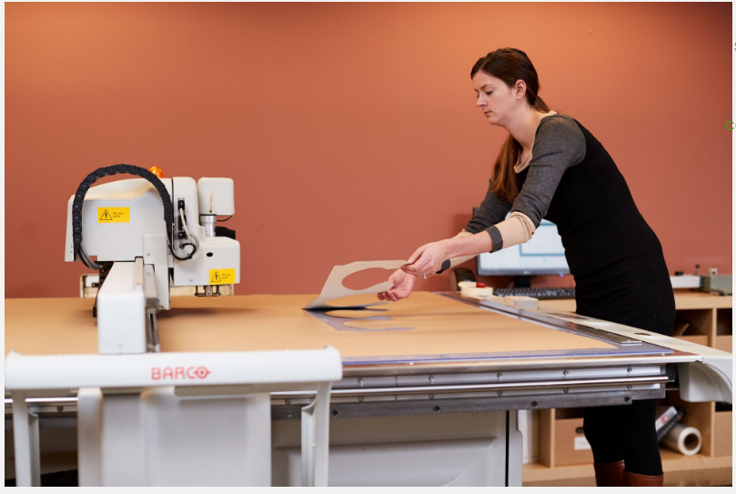
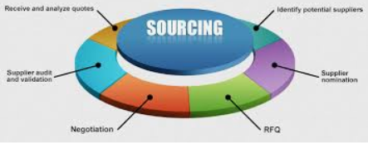

Our sales and project managers are the main points of contact and take full responsibility for each program. These professionals are insight knowledgeable in all aspects related to packaging, including materials, design and distribution.
4 Pillar of our success
Packaging Solutions
Sales, marketing and project managers
Engineering, design and testing
Sourcing
Quality and compliance
Our design and engineering teams create custom packaging solutions to provide savings to the customer. They extend graphics across products, optimise structural design and conduct rigorous performance testing, so your packaging can be implemented consistently
Effective sourcing is a critical aspect of any supply chain. Our sourcing team ensures the capabilities and capacity of each vetted supplier. They identify the best value and materials to anticipate each customer's needs.
Our regional quality and compliance teams assess our production network, making sure all packaging meets or exceeds the requirements of our customers. They monitor and audit packaging facilities to ensure compliance.
Ingenious Solutions

Slide 8
Packaging Solutions
Ingenious
‘Packaging Deployment’
Ingenious Solutions

Slide 9
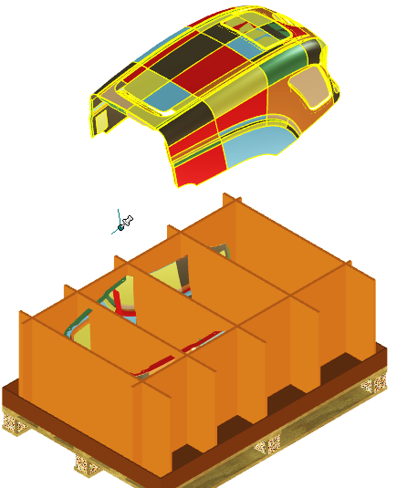
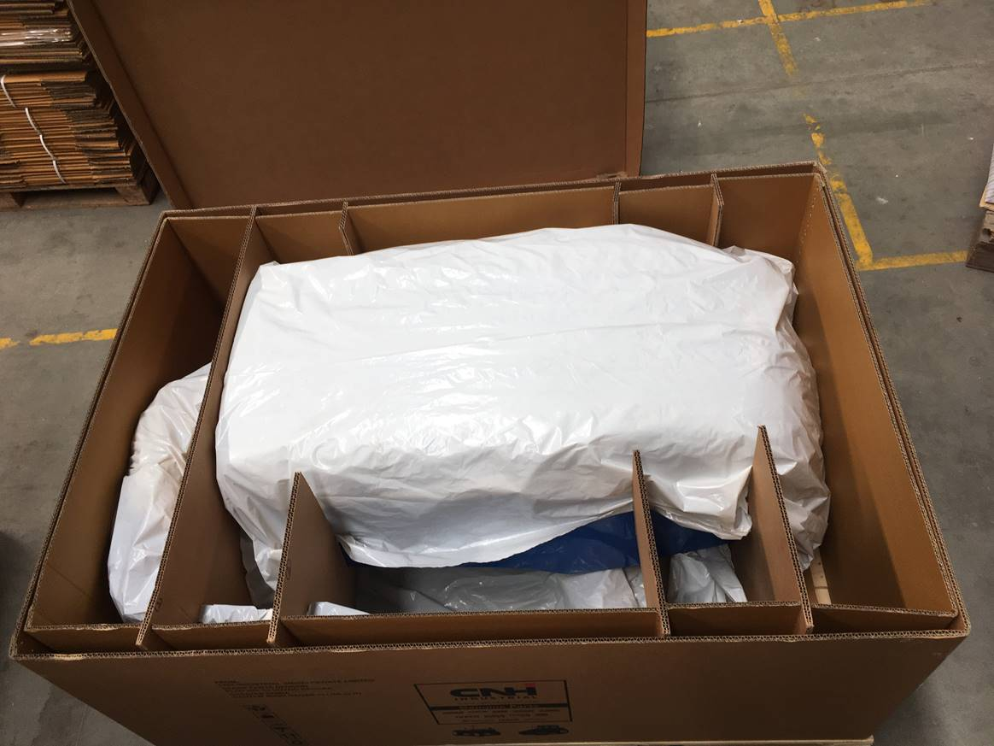
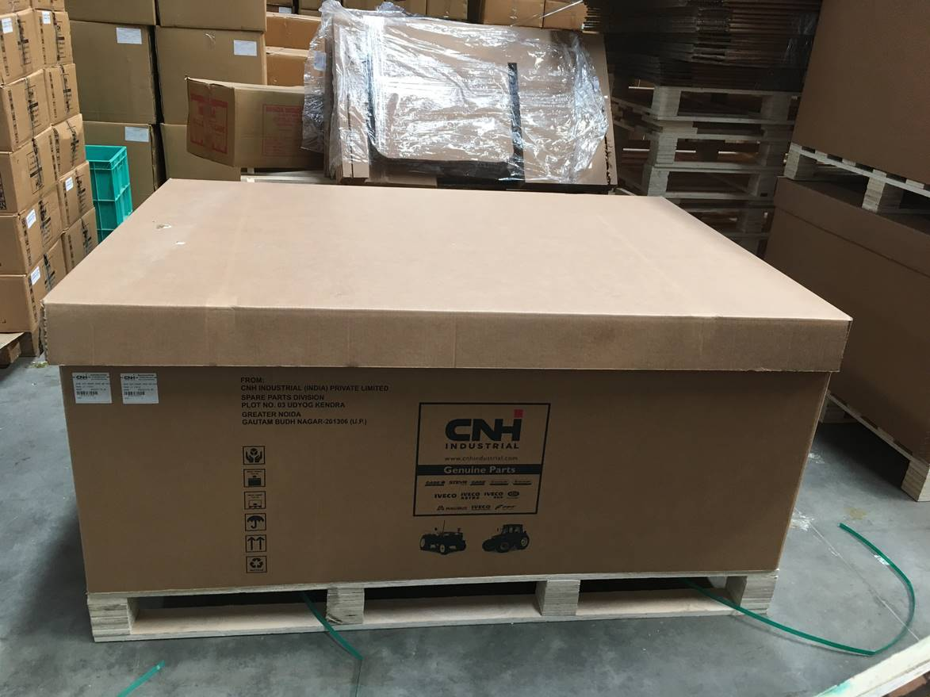
Packaging Solutions
Packaging Designs – 2 Tractor Hoods in one Box
Ingenious Solutions

Slide 10
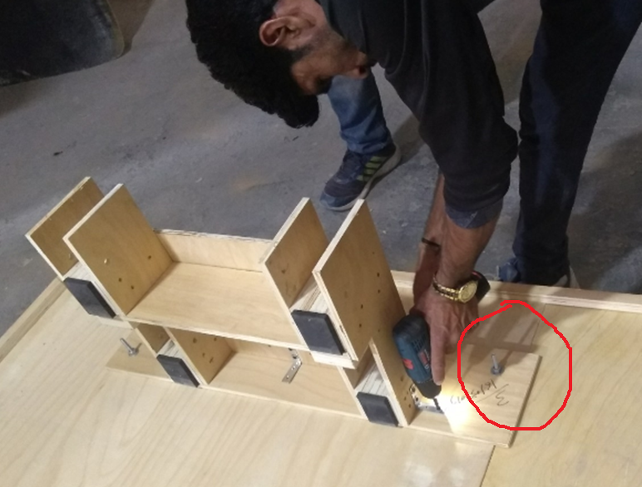
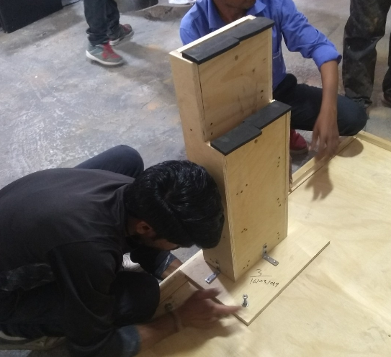
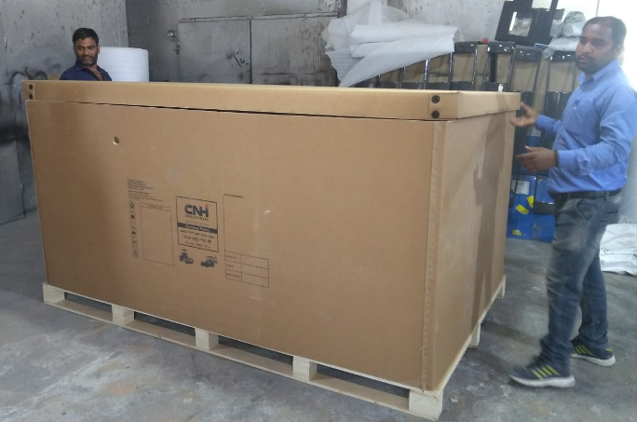
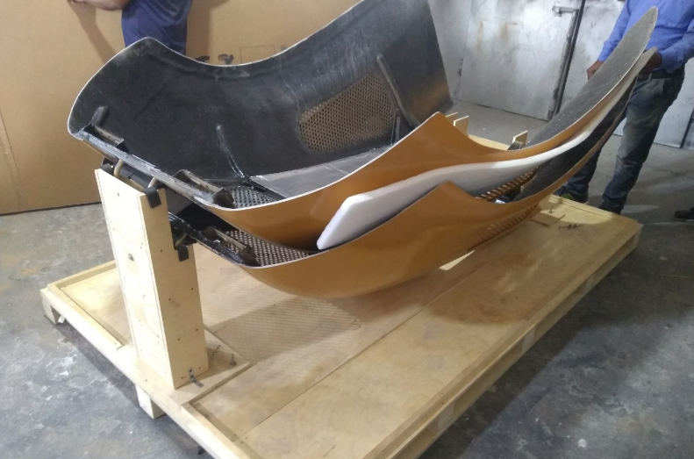
Packaging Solutions
Packaging Designs – 2 Backhoe Loader Hoods in one Box
Ingenious Solutions

Slide 11
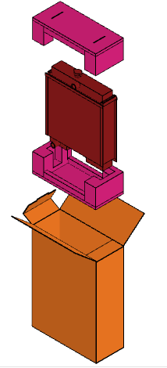
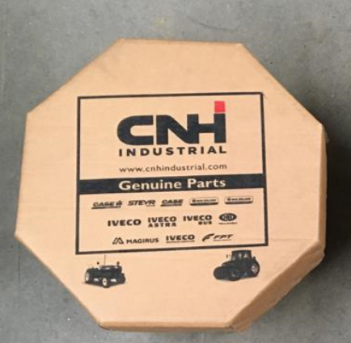
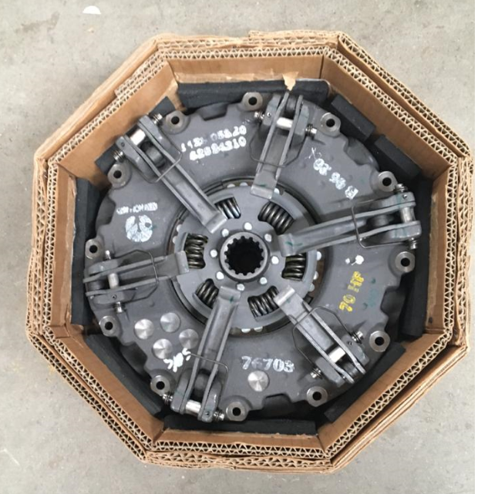
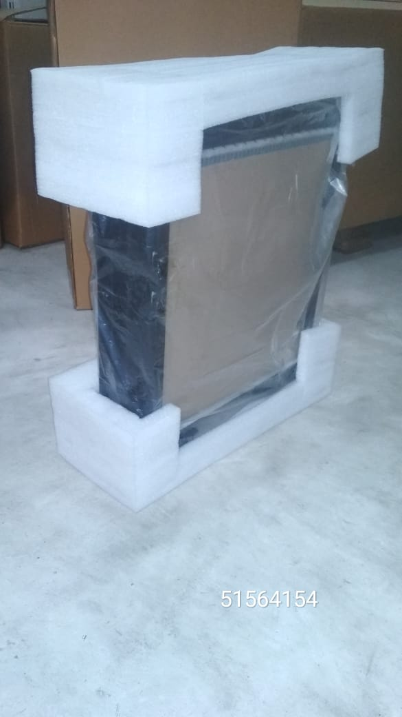
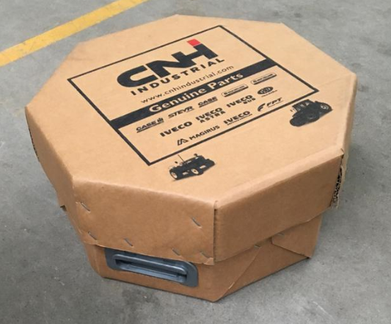
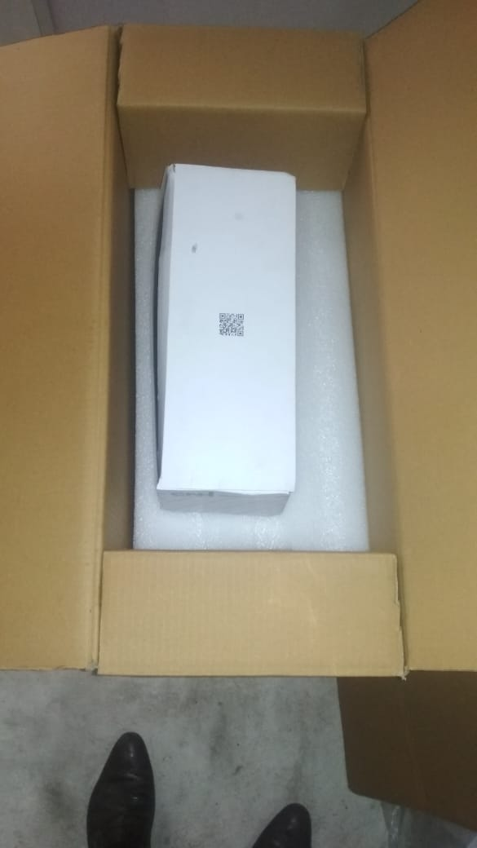
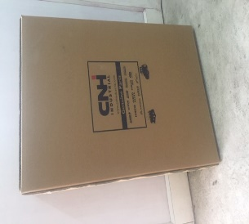
Packaging Solutions
Ingenious Solutions
Clutch Assembly
Radiator
Ingenious Solutions

Slide 12
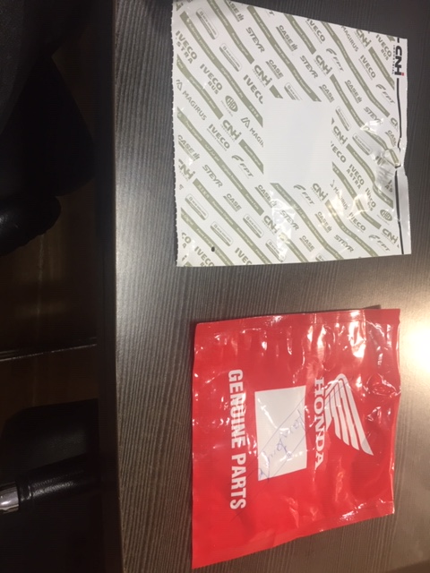
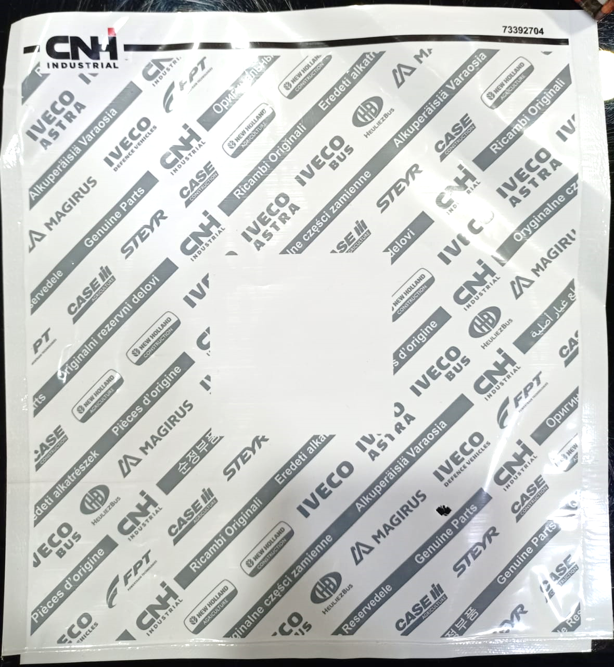
Packaging Solutions
Ingenious Solutions
Improvement in Plastic pouches
Before
After
Normal poly pouches
Laminates
Laminates are multilayer film which has ;-
Better strength than normal poly pouches .
Long lasting printing quality .
Ingenious Solutions

Slide 13
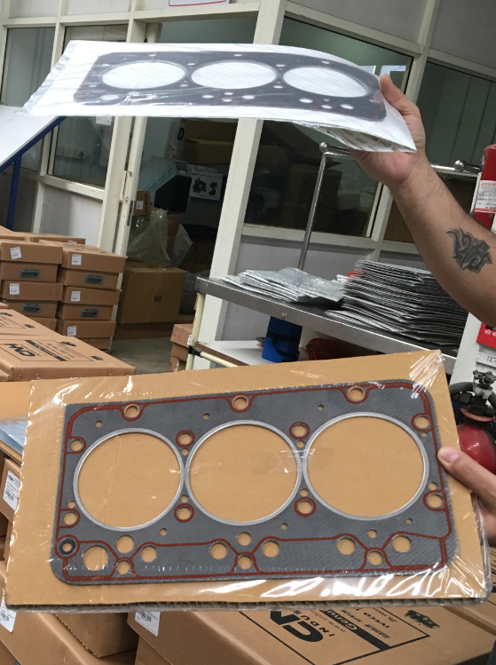
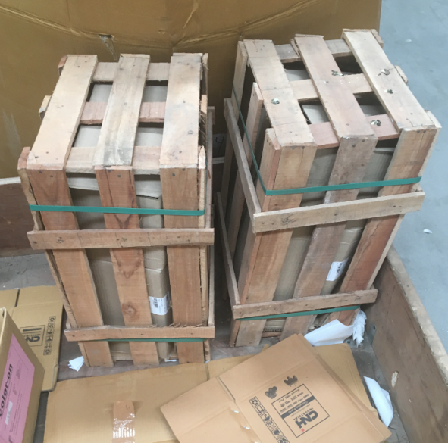
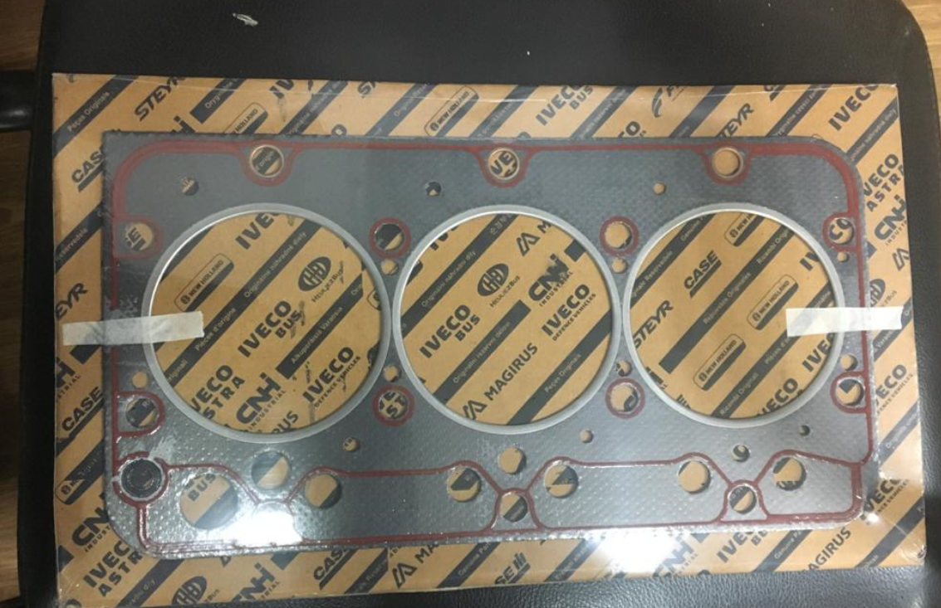
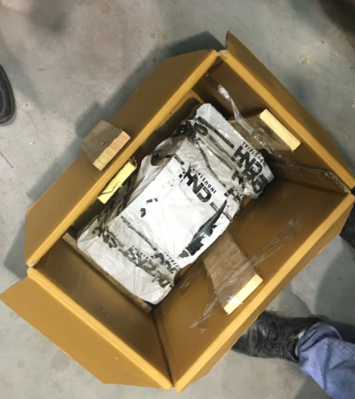
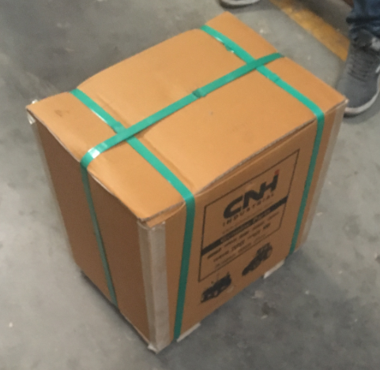
Packaging Solutions
Ingenious Solutions
Before
Before
Sustainable Solution
Gasket Packaging improvement
After
After
Ingenious Solutions

Slide 14
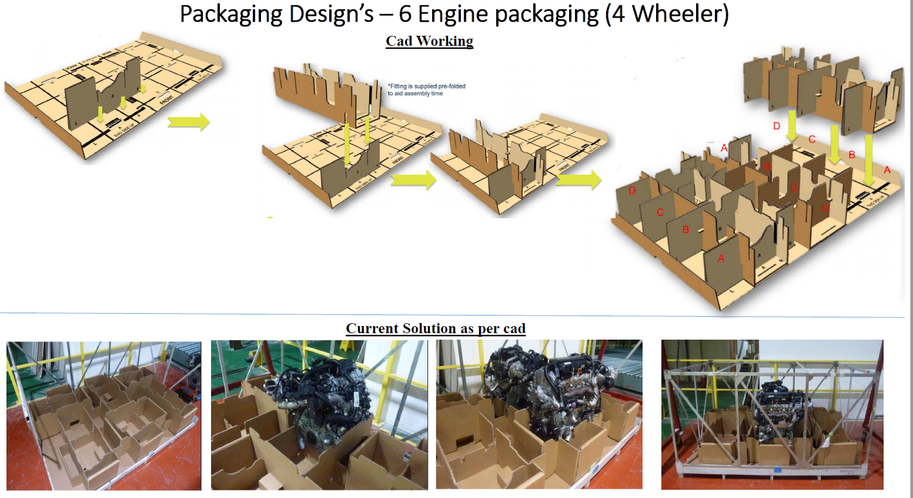
Packaging Solutions
Ingenious Solutions

Slide 15
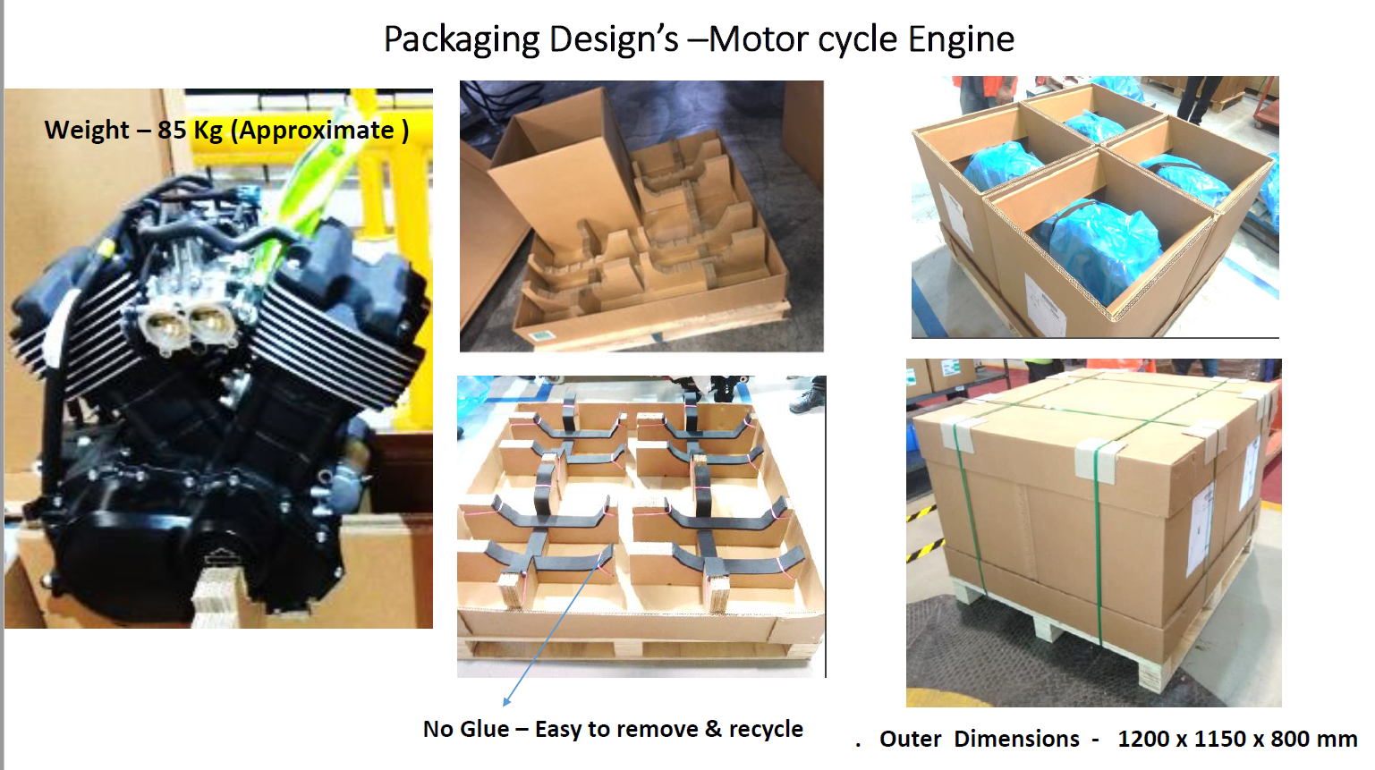
Packaging Solutions
Ingenious Solutions

Slide 16
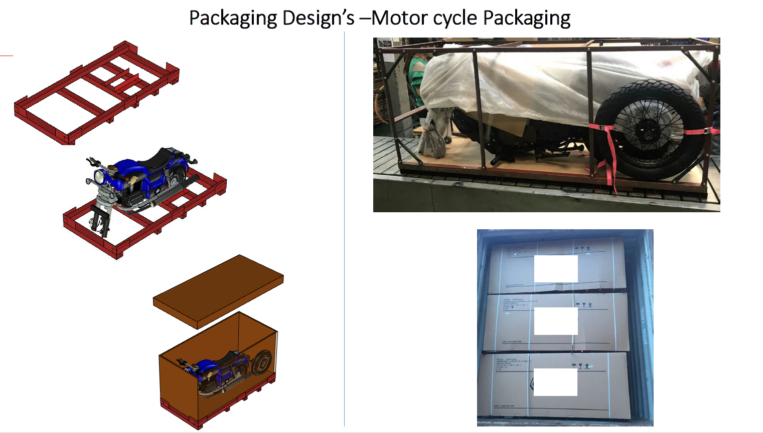
Packaging Solutions
Ingenious Solutions

Slide 17
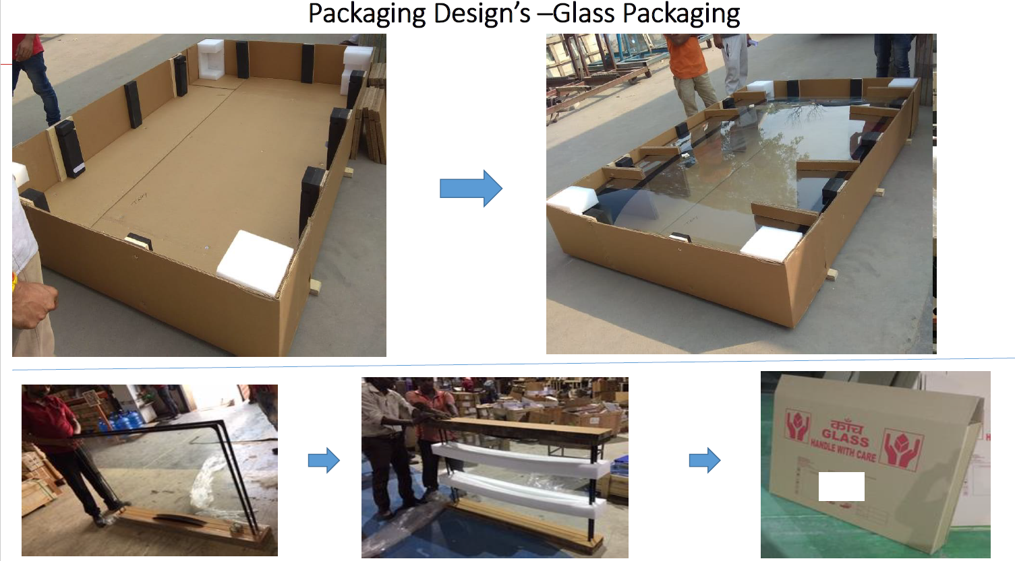
Packaging Solutions
Ingenious Solutions

Slide 18
Packaging Solutions
Ingenious ‘Case Study’
VAVE
Ingenious Solutions

Slide 19
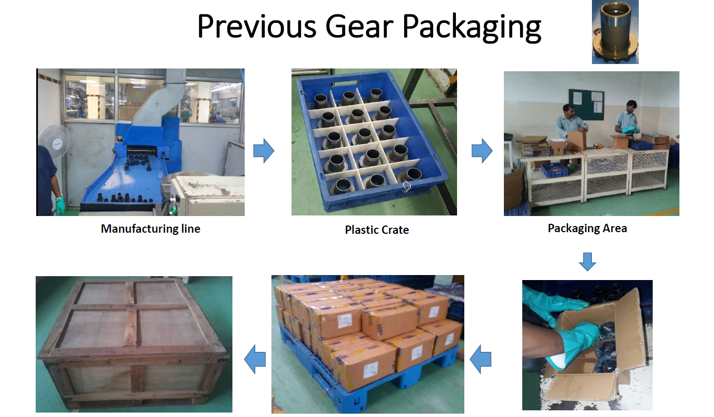
Packaging Solutions
Ingenious Solutions

Slide 20
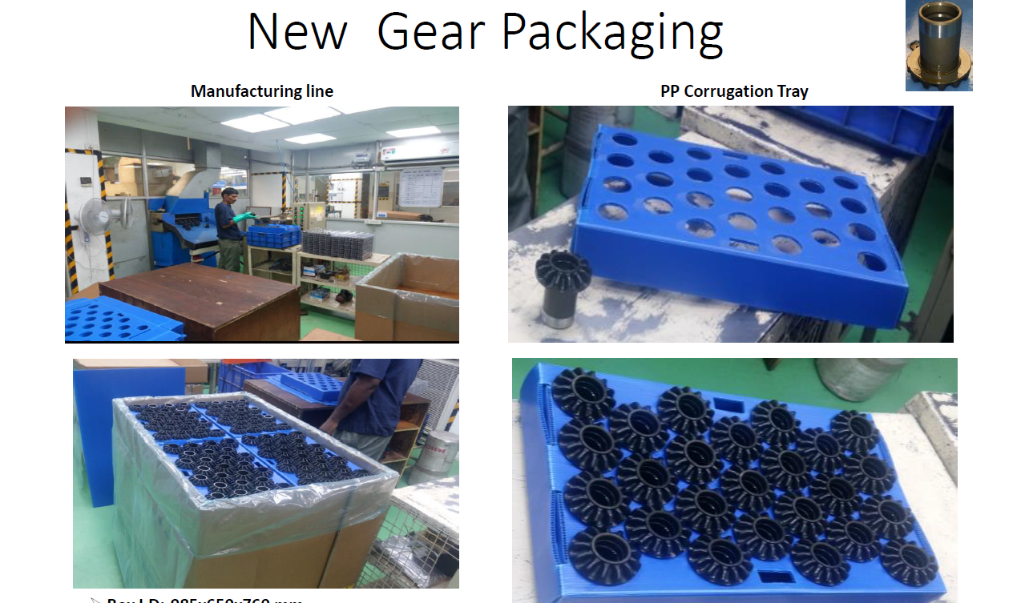
Packaging Solutions
Ingenious Solutions

Slide 21
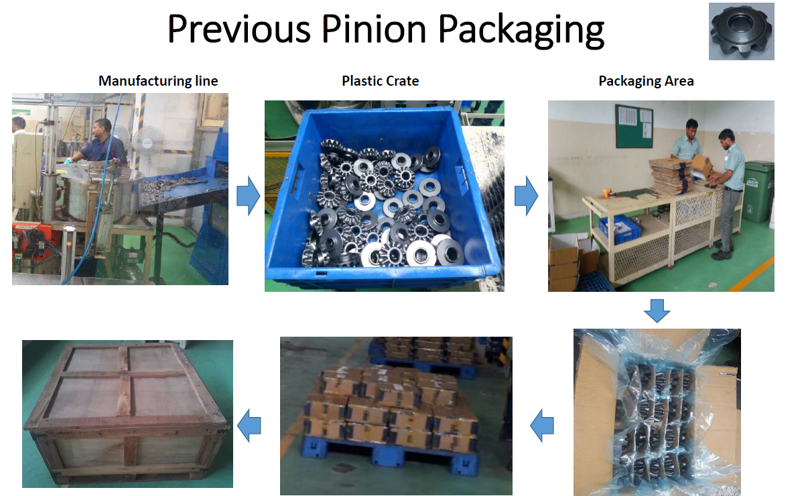
Packaging Solutions
Ingenious Solutions

Slide 22
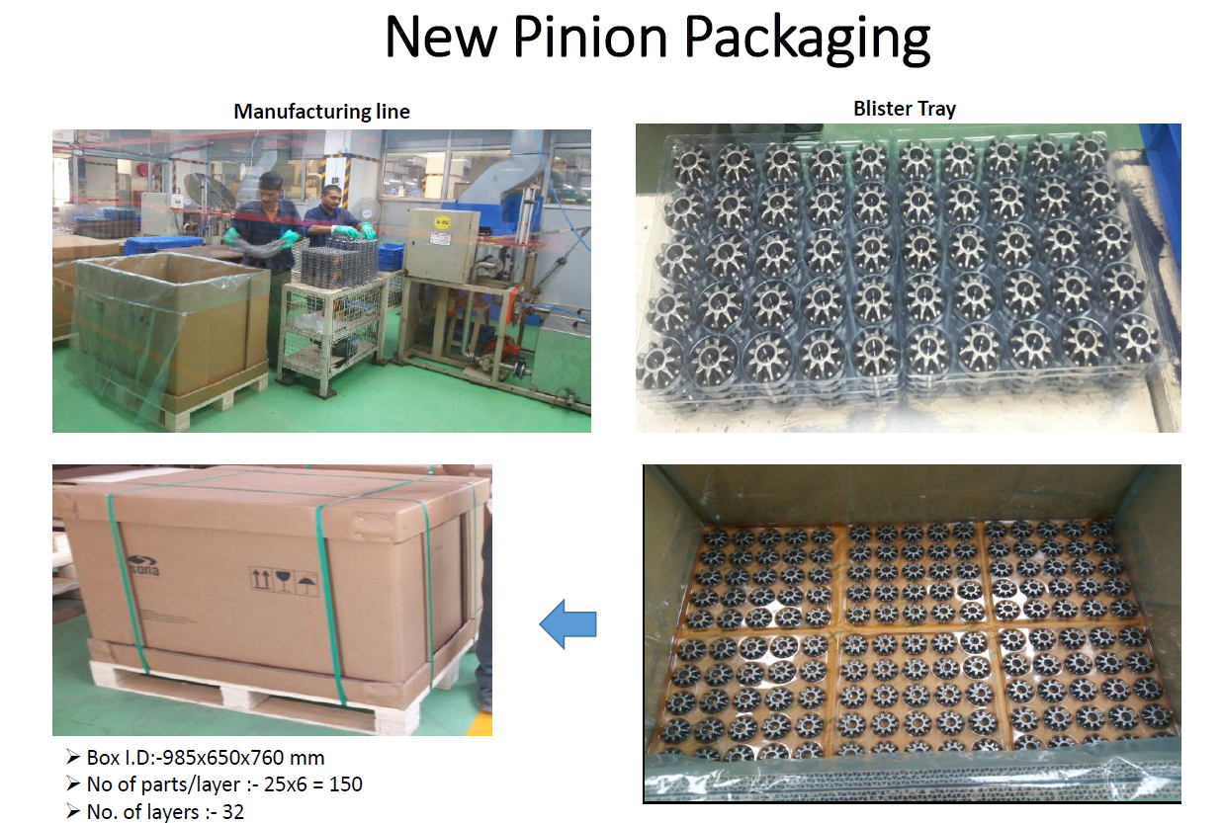
Packaging Solutions
Ingenious Solutions

Slide 23
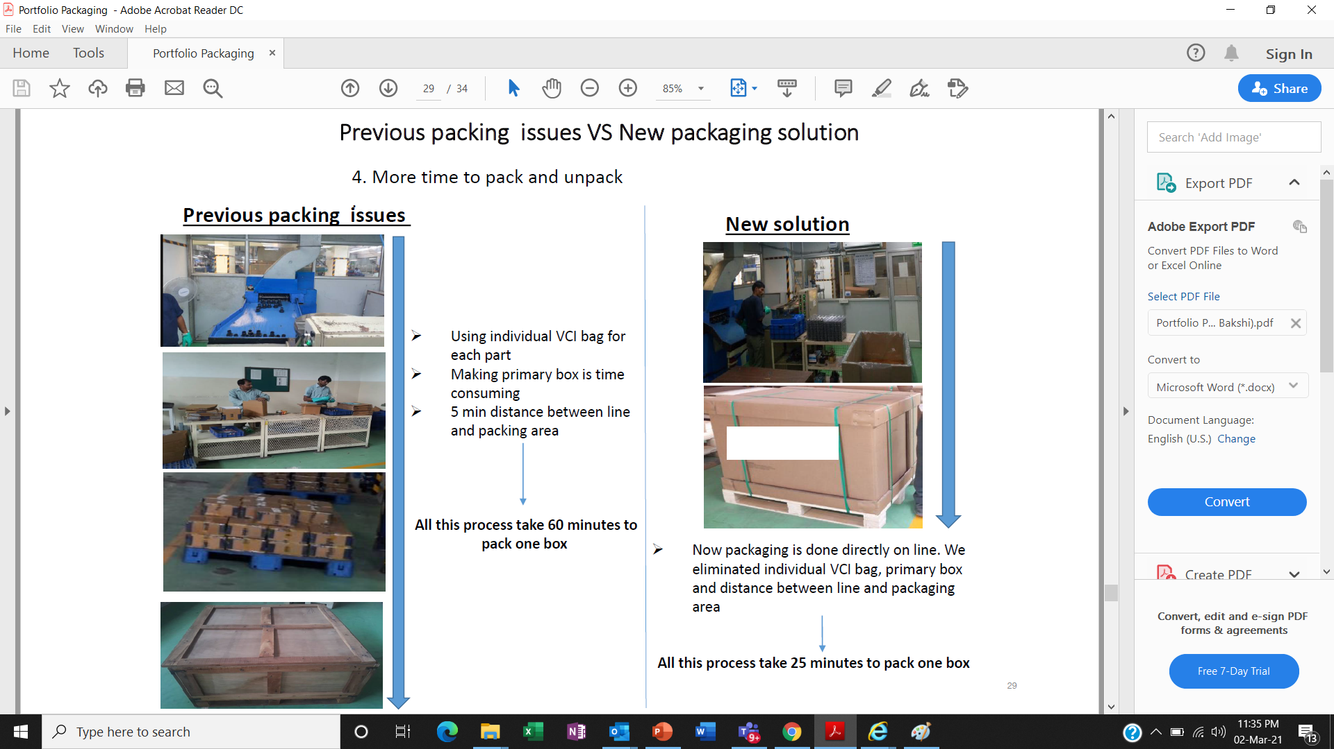
Packaging Solutions
Ingenious Solutions

Slide 24
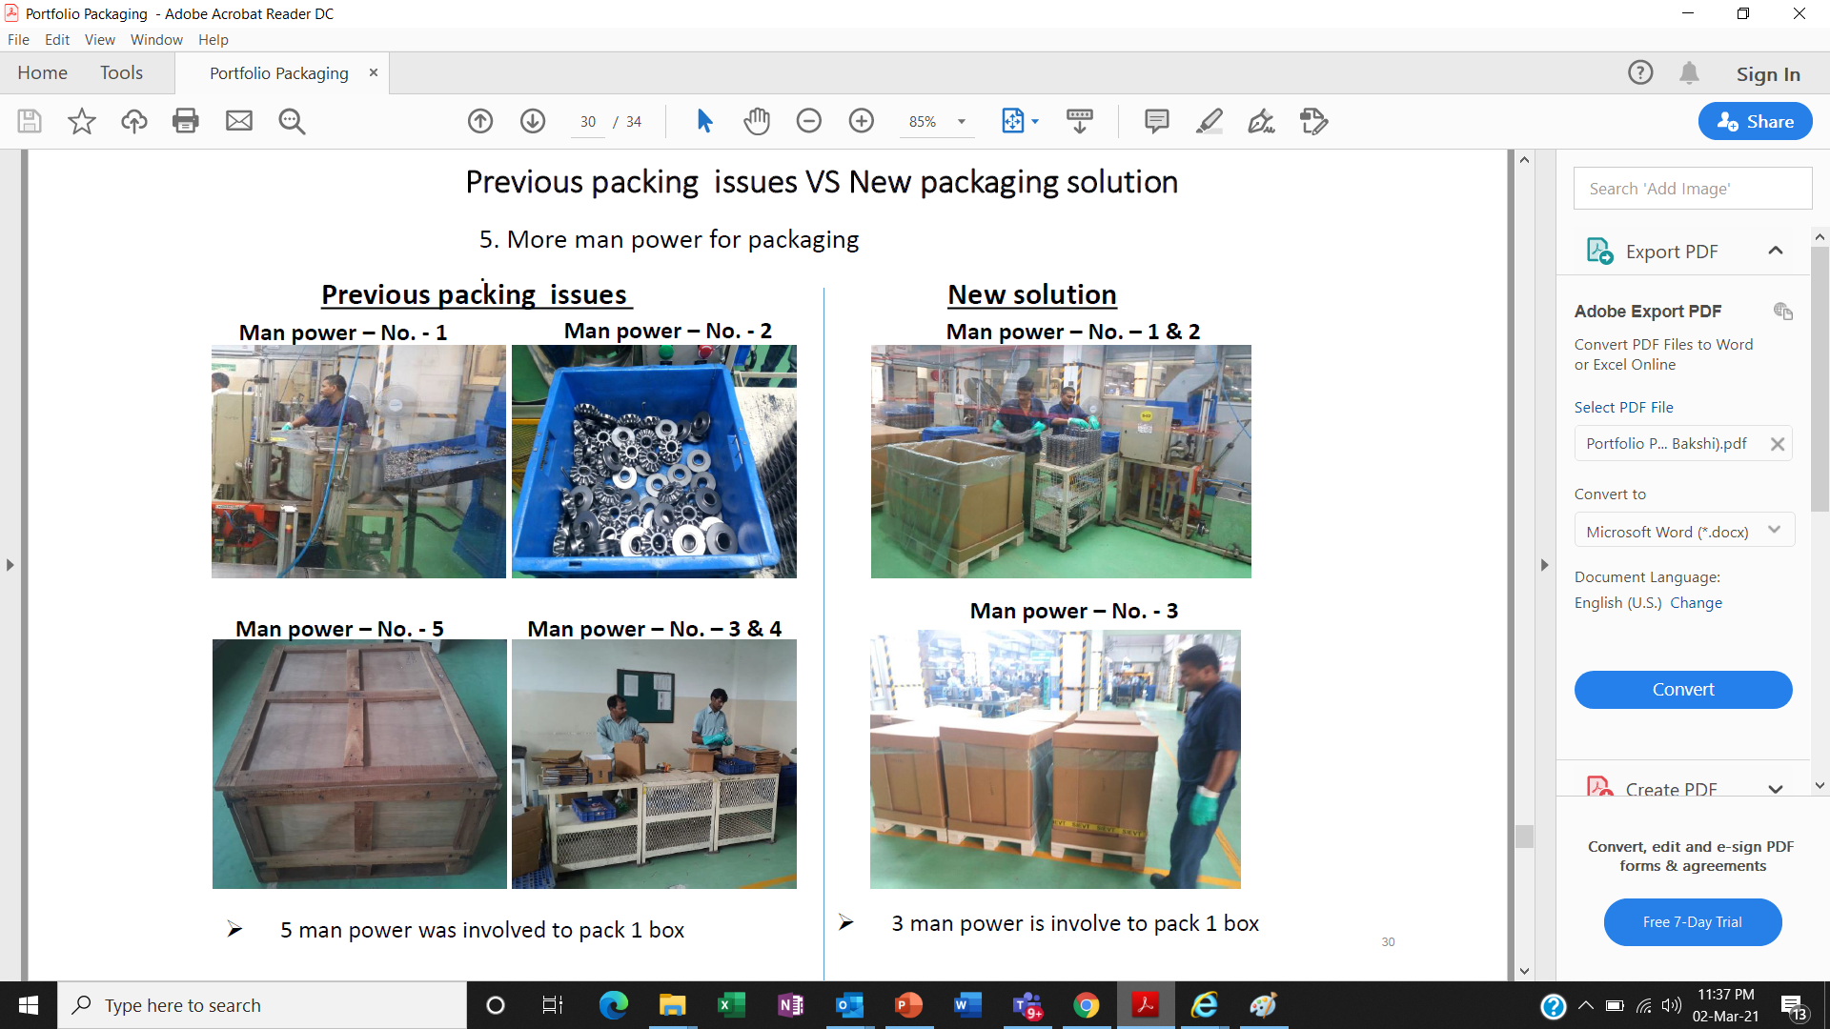
Packaging Solutions
Ingenious Solutions

Slide 25
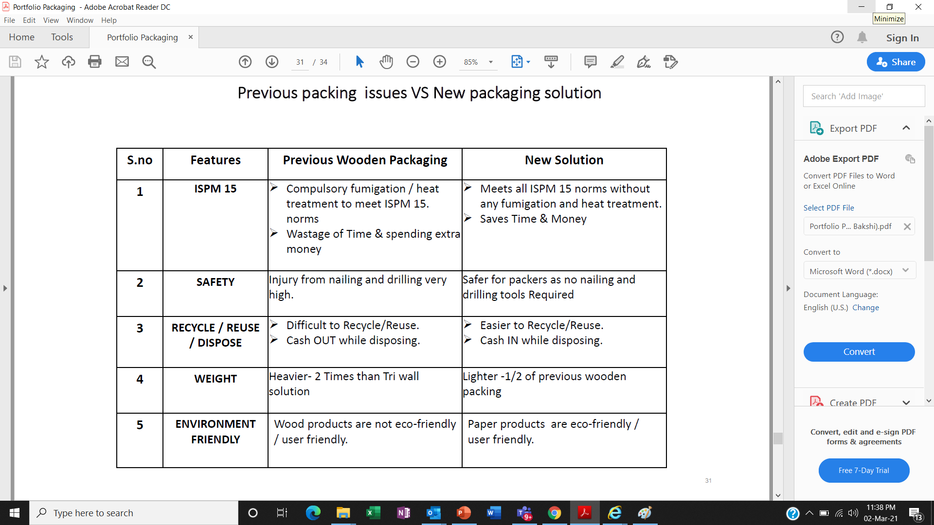
Packaging Solutions
Ingenious Solutions

Slide 26
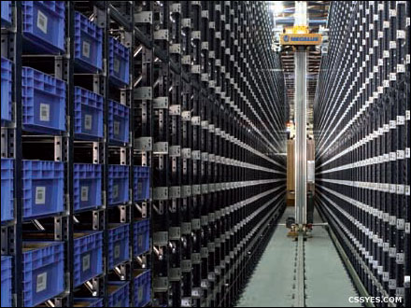
Warehousing & Logistics Solutions
Warehousing
Warehouse Setup with & without 3PL.
Transformation from Traditional to Automation.
Warehouse Operational Efficiencies.
ERP/WMS Implementations.
Resource Management and Trainings.
Ingenious Solutions

Slide 27
Warehousing Solutions
What Ingenious ‘Can Do’
Warehouse Setup
System Enhancement
Efficiencies Enhancement
Financial Viability
Ingenious Solutions

Slide 28
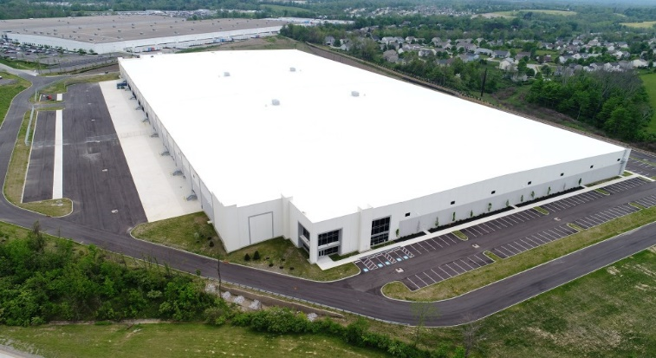
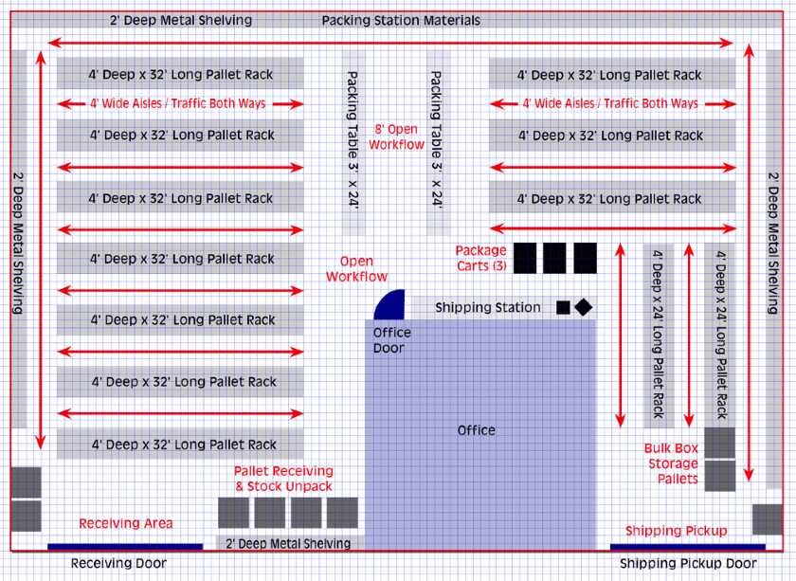
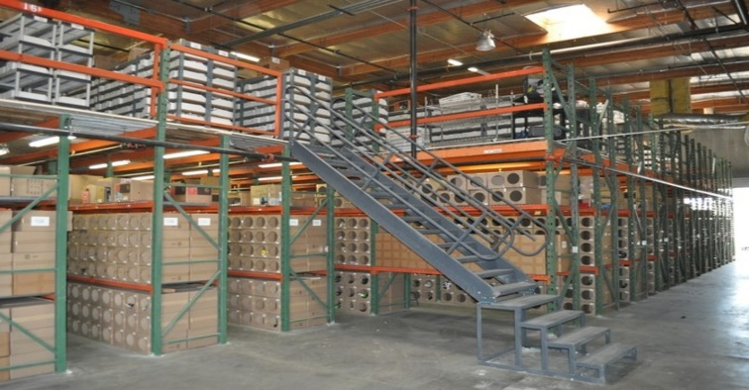
Warehousing Solutions
Warehouse Setup
End to End RFQ run
SOW - Operations
Data Collection
Project Charter/Cover Letter
Location Finalization
Facility Study & Feasibility
Roads, Highways & Traffic Flow
Warehouse Design
Trends in Facilities
Storage Space /Cube
Operational requirements
Capex Finalization
Project Execution
Final Setup
Operation Ramp up
Ingenious Solutions

Slide 29

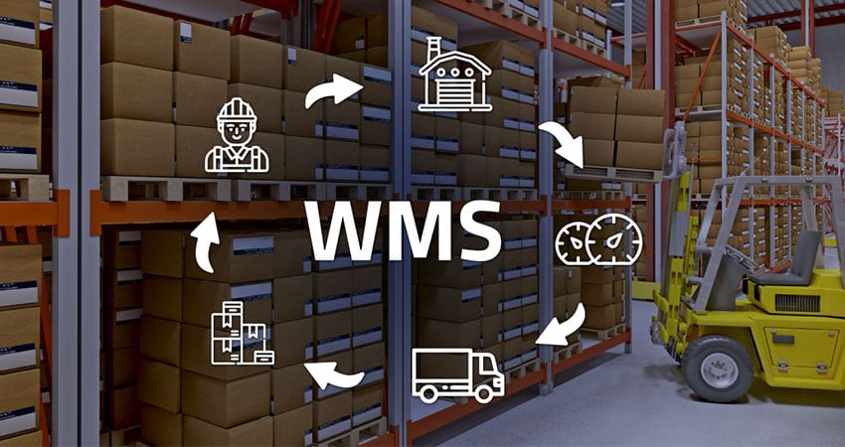
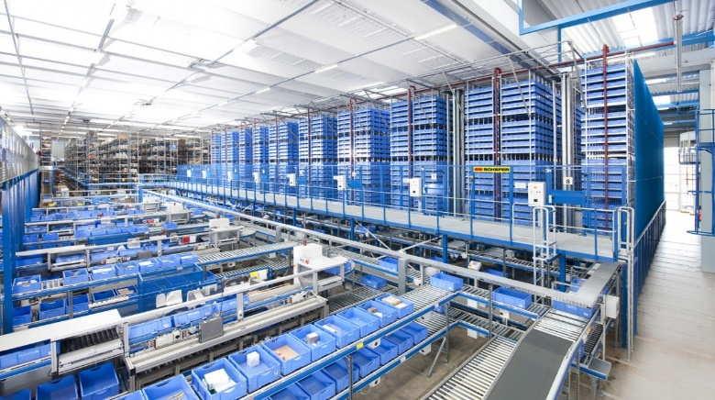
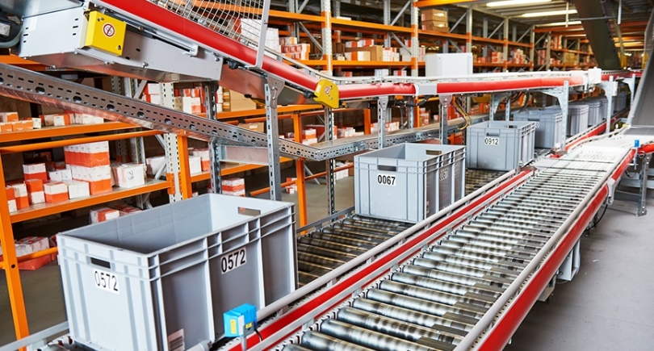
Warehousing Solutions
System Enhancement
ERP Implementation
WMS Implementation
Automation –
Packaging
Sorting
Storing
Ingenious Solutions

Slide 30
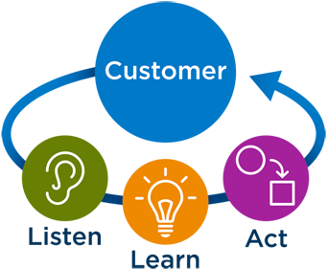
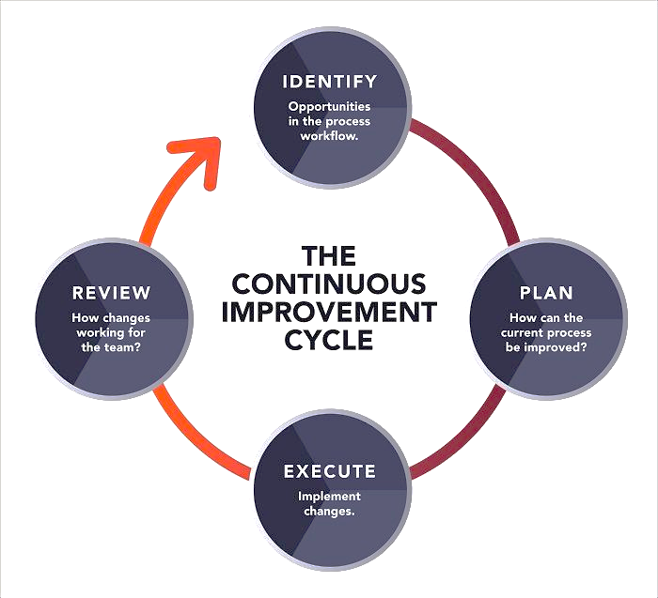
Warehousing Solutions
Efficiencies Reform
Customer Needs-
Just in time
Speed
Process Improvement
Inbound
Prepacking
Outbound
Team Management
Fit for role hiring
Process / Ops Training
Motivation
Inventory Management
Visibility
Stock Levels
Ordering
Ingenious Solutions

Slide 31


Warehousing Solutions
Financial Viability
Improving Cost Structure
Opex Cost Reduction
Key performance indicators
Intangible cost reduction
Dealer Claim Reduction
In transit Damage Reduction
Ingenious Solutions

Slide 32

Logistics & Warehousing Solutions
Logistics
B2B (also known as business-to-business)
B2C (also known as business-to-consumer)
Geographical Possibilities (Domestic /Export)
E-Commerce (First Mile, Last Mile, Returns)
Ingenious Solutions

Slide 33
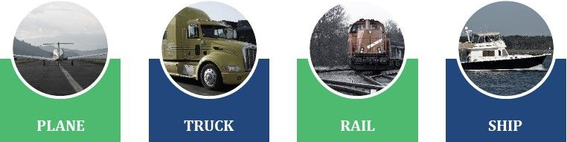
Logistics Solutions
Mode of Logistics
Ingenious Solutions

Slide 34
Logistics Solutions
What Ingenious ‘Can Do’
Study Solution Deployment
Packaging solution tailored for maximum logistics capacity utilization and strengthening value on investment.
Offer FTL or LTL/Part Load logistics services based on business regional requirements – Domestics & Export.
Introduce best suit logistics service providers with optimized solution.
Address the field / regional concerns via logistics solution designing for end customer / dealer satisfaction.
Solutions on E-Commerce based on business requirements.
Ingenious Solutions

Slide 35
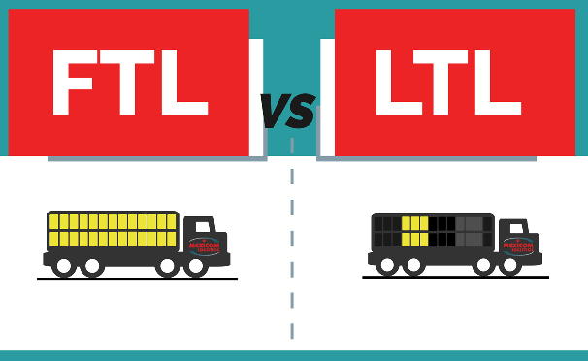
Logistics Solutions
Mode of Distribution
Ingenious Solutions

Slide 36


Our Key Customer Base
Ingenious Solutions

Slide 37

Ingenious Solutions

